Slide 1
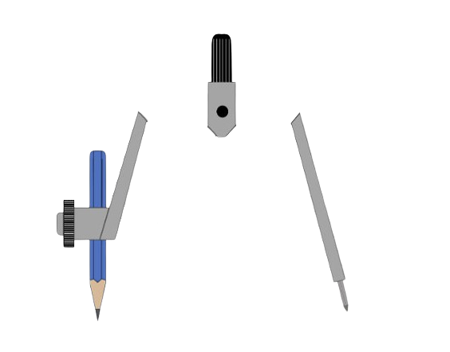
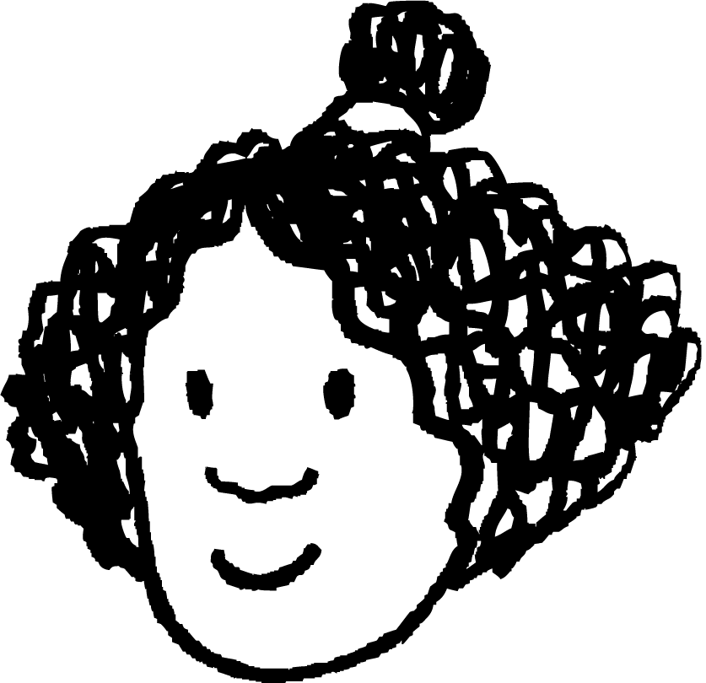
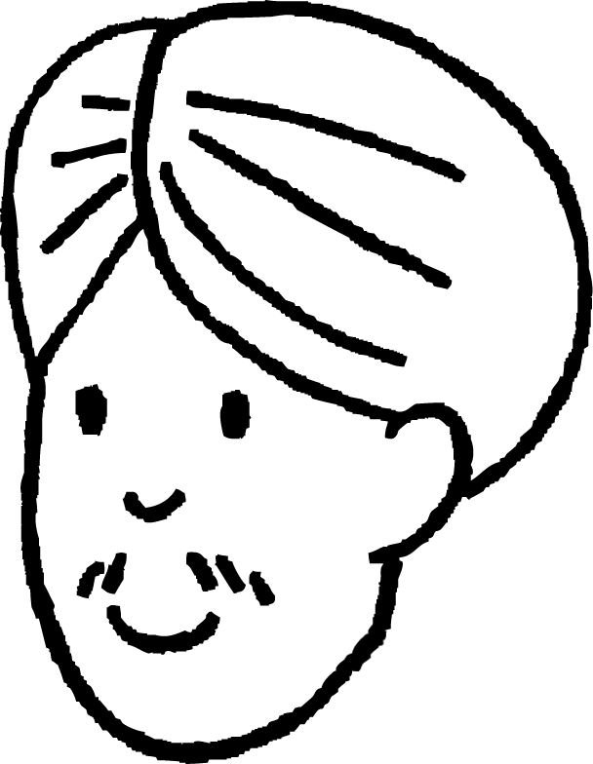
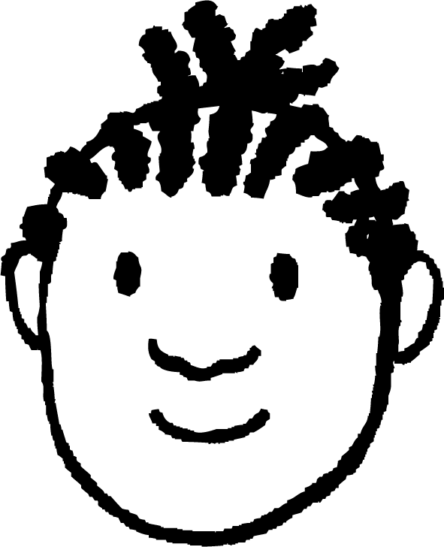
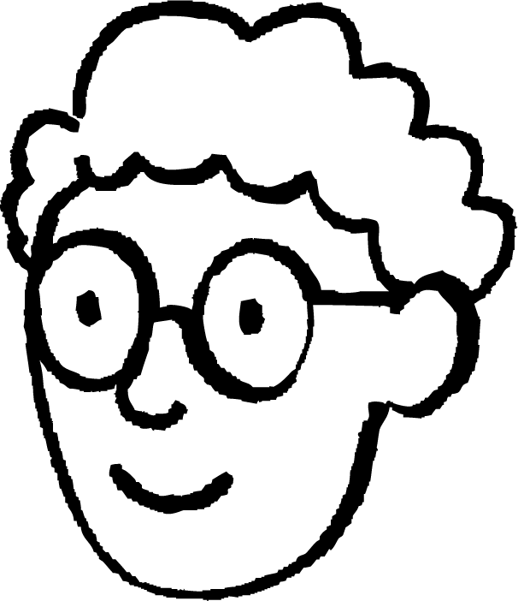
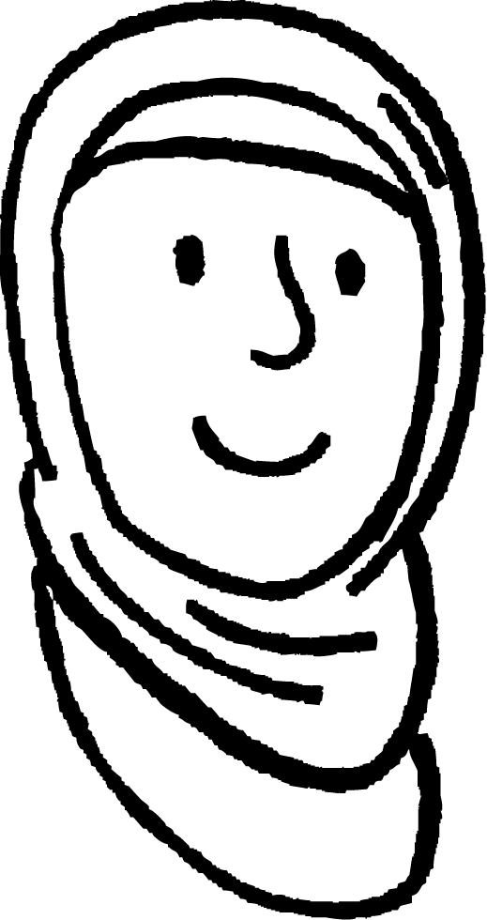
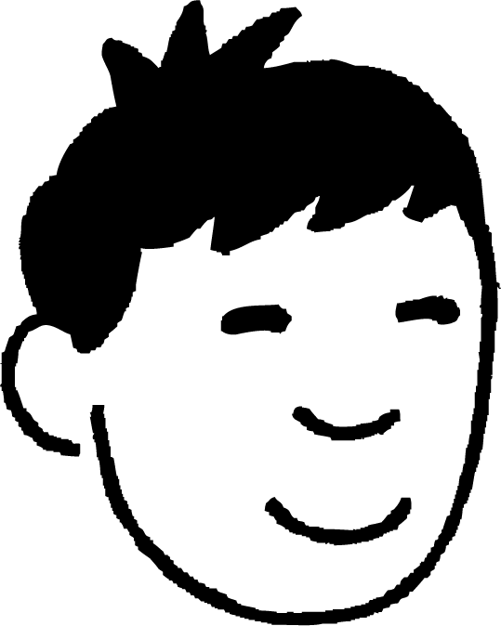
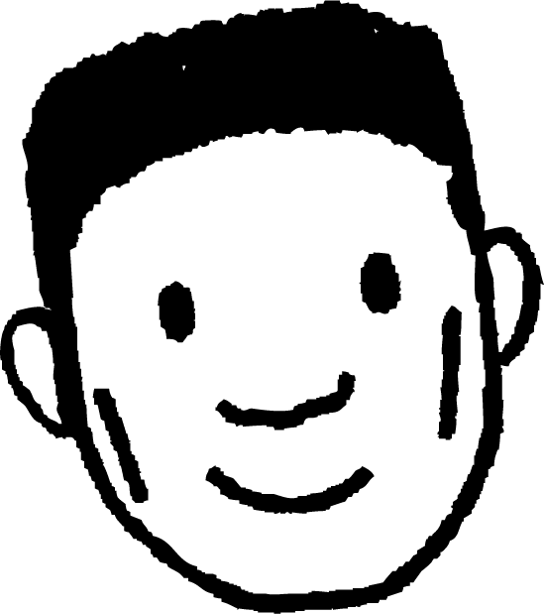
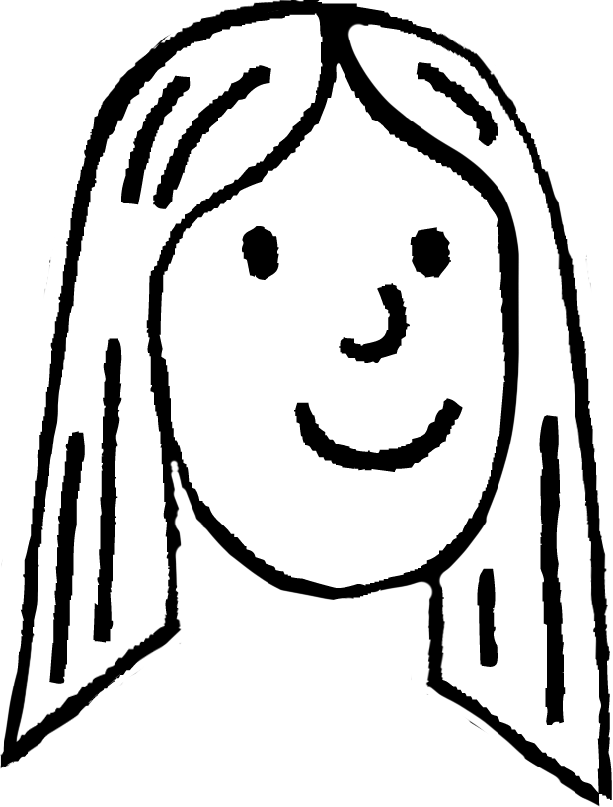
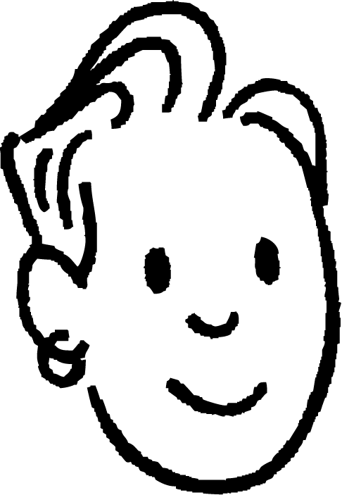
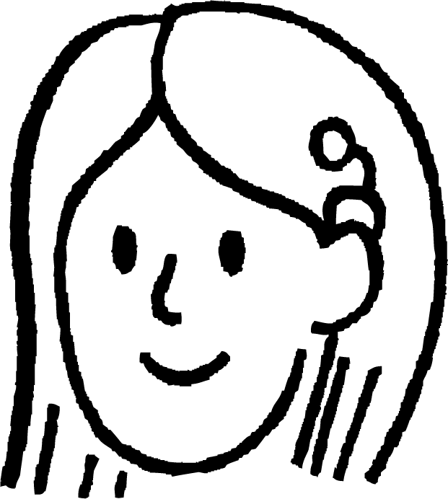
Understanding constructing a circle
Task A: Properties of a circle
1) You will need a blank piece of A4 paper for question 1. It will not fit on this sheet. Mark a cross in the middle of your plain piece of paper. a) Mark 8 points that are exactly 7 cm away from the cross. b) Draw a circle with radius 7 cm and with the centre at the cross. c) What do you notice about the points from part (a) and the circle from part (b)?
E.g. Not drawn to scale.
5 cm
All of the points lie on the circle.
2) Aisha marks a cross on a piece of paper and marks a point exactly 5 units away from it. She asks everyone else to mark a point 5 units away from the cross.
Izzy
Andeep
Jacob
Alex
Aisha
Jun
Lucas
Laura
Sam
Sofia
a) How could you use a pair of compasses to check whether everyone’s point is the correct distance away from the cross?
b) Whose point is too close to the cross?
c) Whose point is too far from the cross?
Draw a circle with the cross at the centre and Aisha’s point on the circle.
Jacob
Sofia

Slide 2
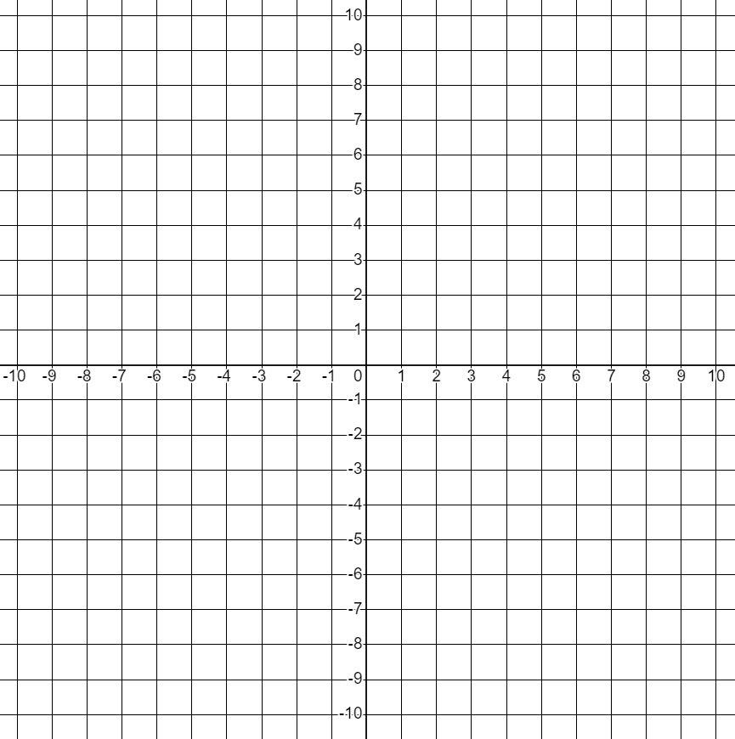
Understanding constructing a circle
3) Find the coordinates of 12 points which are exactly 10 units from the origin.
(10, 0)
(0, 10)
(-10, 0)
(0, -10)
(8, 6)
(-8, -6)
(6, 8)
(-6, -8)
(-6, 8)
(6, -8)
(-8, 6)
(8, -6)
These are the only coordinates with integer values. There are more coordinates with decimal values.
Task B: Properties of an arc of a circle
1) W, X, Y and Z are arcs from four circles.
A, B, C and D are four possible centres for these circles.
Match the arcs to their centres.
W
Z
X
A and Y
B and X
C and W
D and Z
A
D
B
C
Y
Mathematics in Education and Industry.
v2.3

